Slide 1
BRILLIANT BUTTONS
Little launch pads that make awesome-ness happen

Slide 2
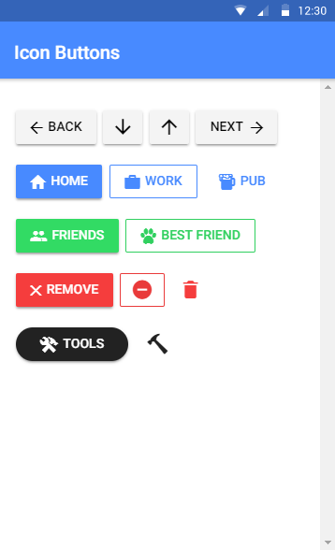

Brilliant Buttons
If lists are the most popular component in Ionic, then buttons are a very close second
Buttons are an essential way to interact with and navigate through an app
Buttons can be whatever you need them to be. We can have unique looks and styles or stick with a very familiar format, but their main function is to push and pop pages on and off our navigation stack
Here’s some of the cool things we can do with buttons
Let’s add a button to our app that tells the user that they are being directed to the Past Deliveries screen…

Slide 3
CHALLENGE TIME!
Check out all the cool types of buttons you can make using the Ionic Documentation
Add two or three different types of buttons that suit your app
Share a screen shot on our Discord Community!

